Slide 1

Fast Food Pink Panther Crikvenica
Official Style Guide

Slide 2
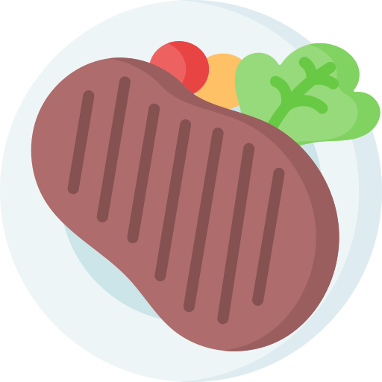

INTRODUCTION
Mercury is the closest planet to the Sun and the smallest one in our Solar System—it’s only a bit larger than the Moon

Slide 3
TABLE OF CONTENTS
01
02
03
Our strategy
04
Typography
Here you could describe the topic of the section
Here you could describe the topic of the section
Our logo
05
Application feel
Here you could describe the topic of the section
Here you could describe the topic of the section
Color standards
Here you could describe the topic of the section

Slide 4
01
OUR STRATEGY
You can enter a subtitle here if you need it

Slide 5
PERSONALITY
Mars
Jupiter
Saturn
Despite being red, Mars is a cold place full of iron oxide dust
Jupiter is a gas giant and the biggest planet in the Solar System
Saturn is composed mostly of hydrogen and helium

Slide 6
02
OUR LOGO
You can enter a subtitle here if you need it

Slide 7

LOGO

Slide 8
LOGO CONCEPT
Mercury is the closest planet to the Sun and the smallest one in our Solar System—it’s only a bit larger than the Moon. The planet’s name has nothing to do with the liquid metal, since Mercury was named after the Roman messenger god

Slide 9
BRAND CONSTRUCTION
5px
5px
Venus has a beautiful name and is the second planet from the Sun. It’s terribly hot—even hotter than Mercury—and its atmosphere is extremely poisonous

Slide 10
CLEAR SPACE REQUIREMENTS
Despite being red, Mars is actually a cold place. It’s full of iron oxide dust, giving the planet its reddish cast

Slide 11
DIMENSIONS
25mm
15mm
150px
100px
60px
Print
Digital
Jupiter is a gas giant and the biggest planet of them all in the Solar System
Saturn is a gas giant and has rings. It’s composed mostly of hydrogen and helium

Slide 12
DOS
Here you can describe the correct uses of your logo
Here you can describe the correct uses of your logo
Here you can describe the correct uses of your logo

Slide 13
DON’TS
Here you can describe the incorrect uses of your logo
Here you can describe the incorrect uses of your logo
Here you can describe the incorrect uses of your logo

Slide 14
03
COLOR STANDARDS
Colors used throughout the project

Slide 15
COLOR STANDARDS
#F8F9FA
#FFC0CB
#F977AA
#F08080 #FF69B4
RGB: 248 249 250
RGB: 255 192 203
RGB: 249 119 170
RGB: 240 128 128
RGB: 255 105 180

Slide 16
COLOR GUIDELINES
CULTURED
PINK
CYCLAMEN
LIGHT CORAL & HOT PINK
Used for navbar and footer background
Used for cards body background
Used for buttons backround
Userd for prices background

Slide 17
04
TYPOGRAPHY
Fonts and font scale used throughout the project

Slide 18
TYPOGRAPHY
Aa
Aa
EBGaramond-Regular
Aa Bb Cc Dd Ee Ff Gg Hh Ii Jj Kk Ll Mm Nn Oo Pp Qq Rr Ss Tt Uu Vv Ww Yy Zz
Used for everything
Aa
EBGaramond-Italic
Aa Bb Cc Dd Ee Ff Gg Hh Ii Jj Kk Ll Mm Nn Oo Pp Qq Rr Ss Tt Uu Vv Ww Yy Zz
Used for food description in menu
Desigers
Aa Bb Cc Dd Ee Ff Gg Hh Ii Jj Kk Ll Mm Nn Oo Pp Qq Rr Ss Tt Uu Vv Ww Yy Zz
Used for page headings and prices
Official Pink Panther font

Slide 19
FONT SCALE
Font scale used in this project is Major Third:
61.04px
48.83px
39.06px
31.25px
25.00px
20.00px
16.00px
Used for heading on home page
Used for headings of pages
Used for heading of main sections
Used for quotes and some subheadings of sections
Used mostly for buttons and card headings
Used for navbar links and prices
Used for descriptions, most often in cards

Slide 20
05
APPLICATION FEEL
You can enter a subtitle here if you need it

Slide 21

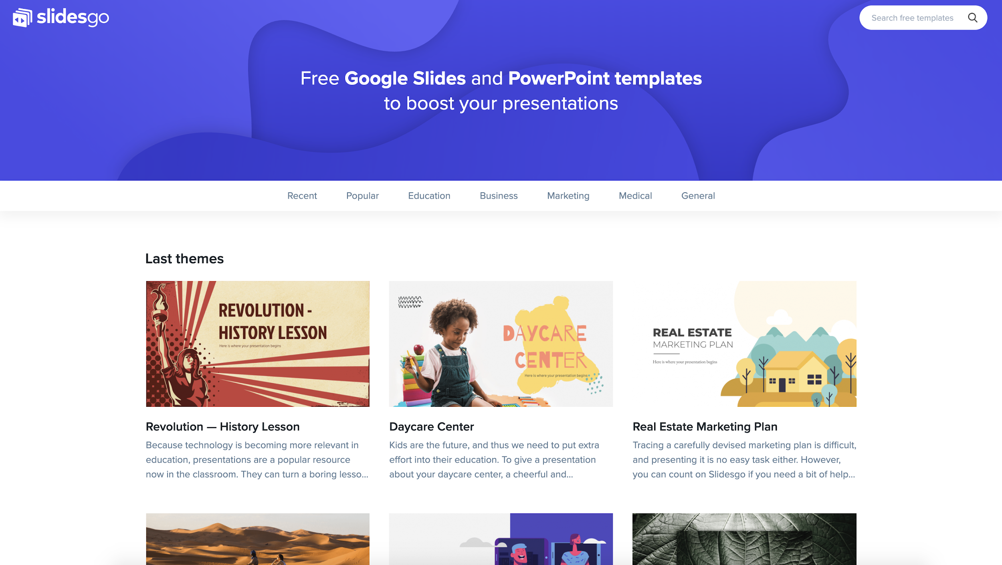
Mockup
You can replace the image on the screen with your own work. Just delete this one, add yours and center it properly

Slide 22
ICONOGRAPHY

Slide 23
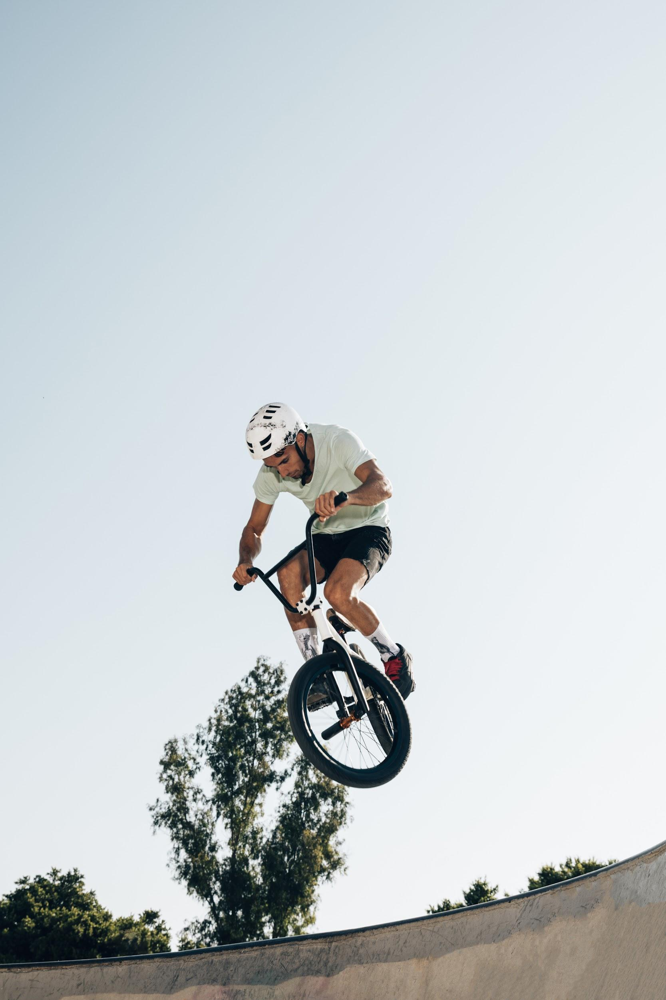
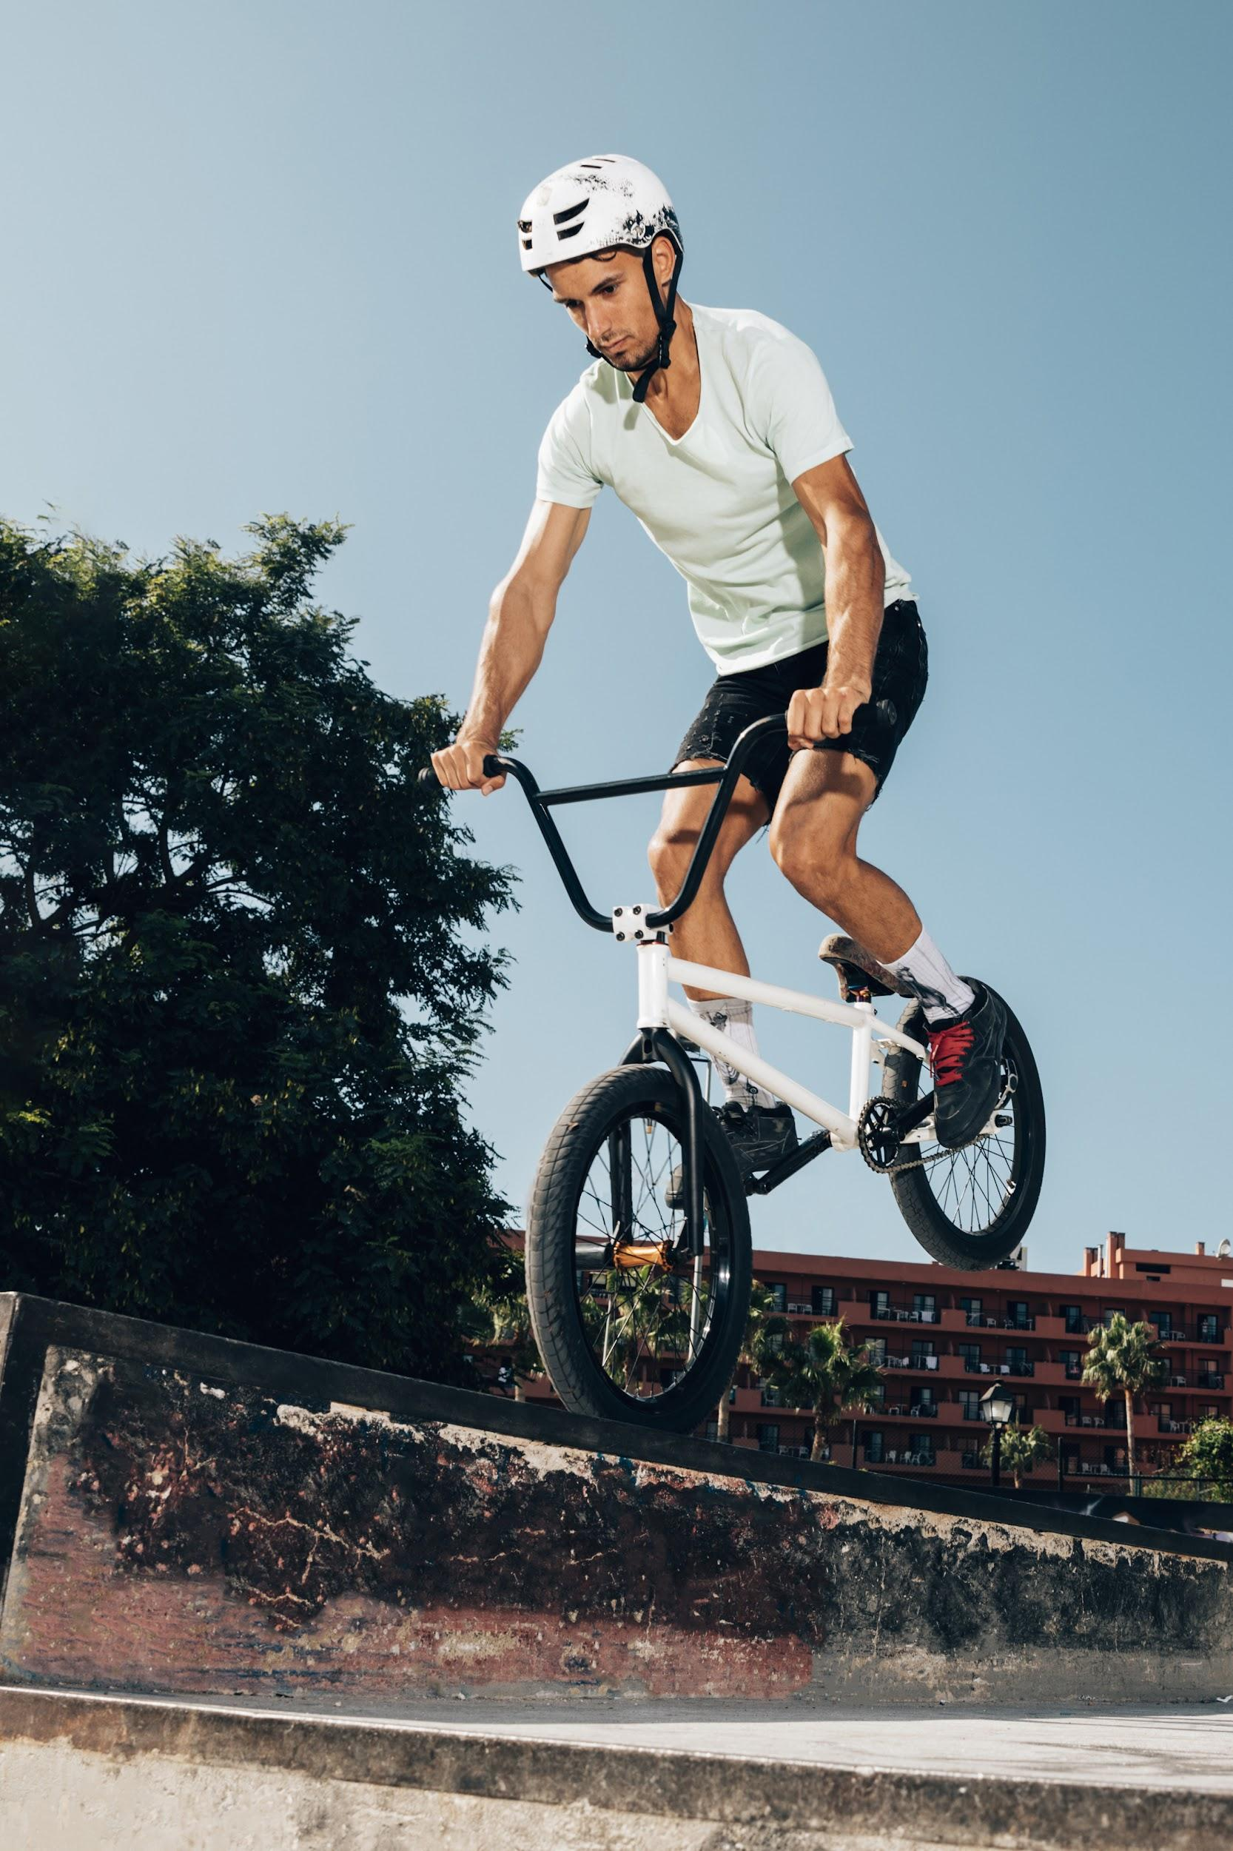
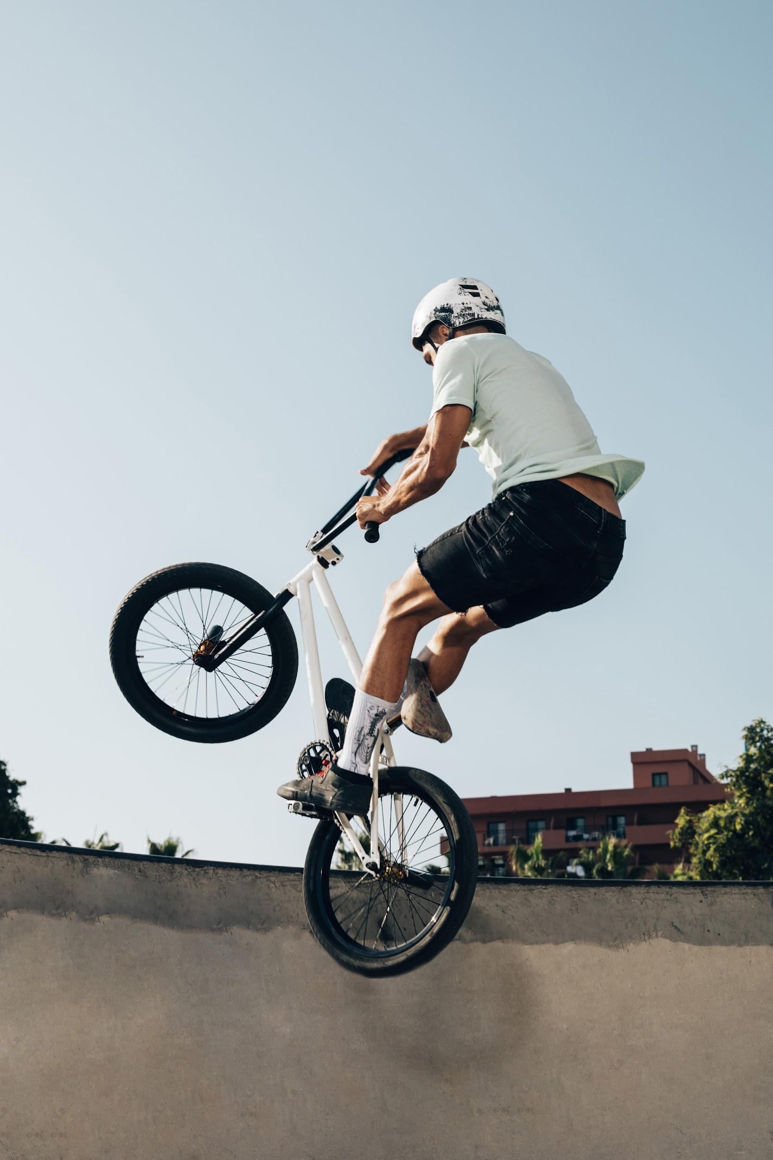

IMAGE GUIDELINES
Venus has a beautiful name and is the second planet from the Sun. It’s terribly hot, even hotter than Mercury

Slide 24
IMAGE CONCEPT
Mercury is the closest planet to the Sun and the smallest one in the Solar System—it’s only a bit larger than the Moon

Slide 25
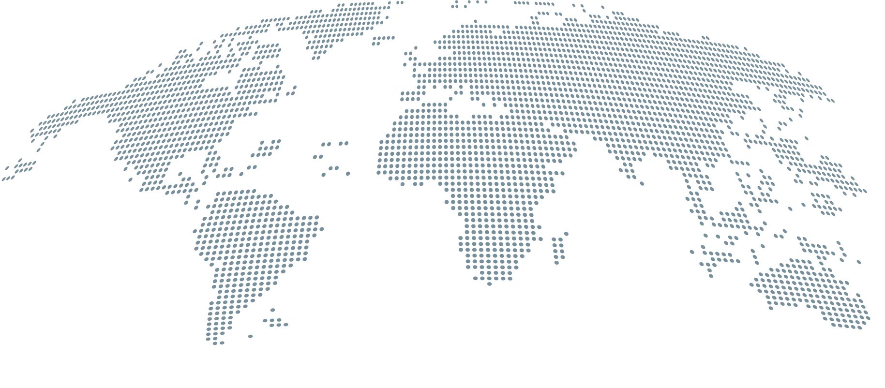
HEADQUARTERS
Jupiter
Jupiter is the biggest planet in the Solar System
Mars
Despite being red, Mars is actually a cold place

Slide 26
OUR HISTORY
1
2
3
4
Venus is the second planet from the Sun
Saturn is a gas giant and has several rings
Despite being red, Mars is a cold place
Mercury is the closest planet to the Sun

Slide 27

“This is a quote, words full of wisdom that someone important said and can make the reader get inspired.”
—Someone Famous

Slide 28
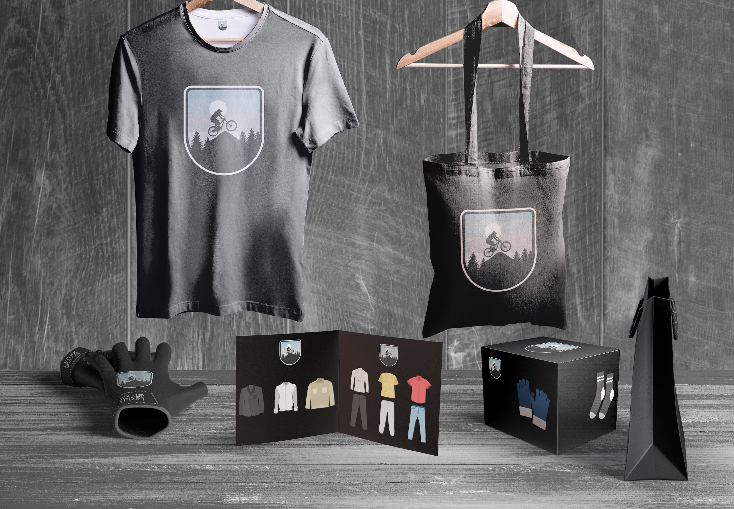
APPLICATIONS
Venus is a planet with a beautiful name and is the second one from the Sun. It’s terribly hot and its atmosphere is poisonous

Slide 29
THANKS!
Do you have any questions? youremail@freepik.com +91 620 421 838 yourcompany.com
Please keep this slide for attribution.

